Slide 1
Multi View Approach to 3D Generative Models
Bryon Kucharski

Slide 2
Introduction
Why Generative Models?
3D Generative Adversarial Network (3D GAN) [1]
Combination of image GAN [2] and volumetric convolutional networks [3]
Main contribution: generates models that are novel and realistic
Introduces both 3DGAN and 3DVAEGAN architectures
Main Goals
Experiment with generative models using multiple input images
Extend unofficial PyTorch implementation [4] to include 3DVAEGAN and Multiview 3DVAEGAN
Notes:
If you can generate data, you can understand the underlying structure of the data
Generative models: Not just what (classification) but also the why (generative)

Slide 3
3D GAN
Real 3D Model (Training Set)
Discriminator
Real
Fake
Fake 3D Model
Z
Generator
Random Z Vector
Notes:
Generator – Can sample new 3D models directly from latent space, no input model required
Discriminator –carries informative features for 3D object recognition
Main point: generates models that are novel and realistic

Slide 4
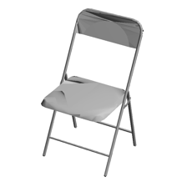
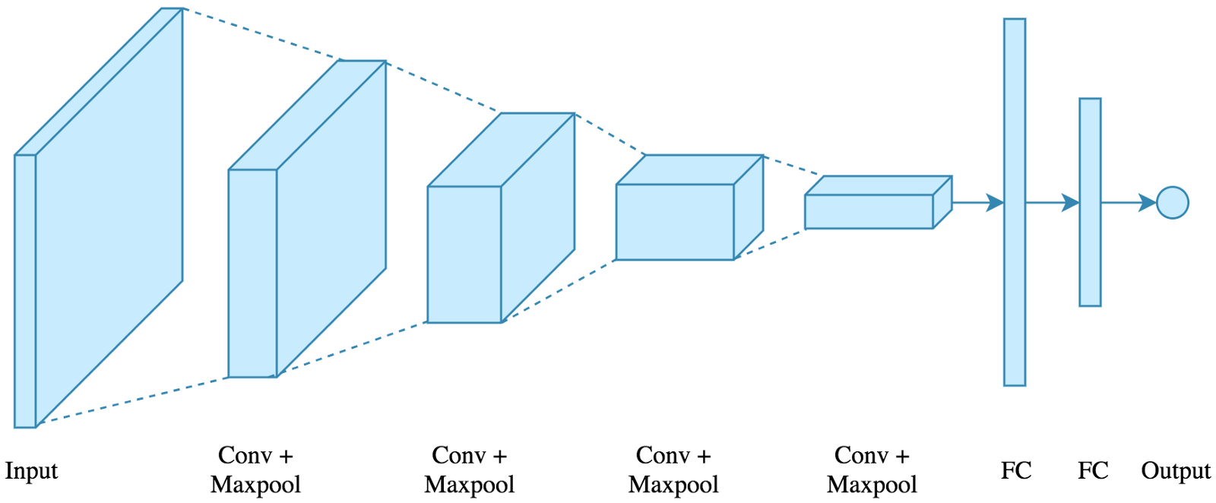
Variational Autoencoder (VAE)
Reconstructed
Image
Input Image
Z
Mean
Std

Slide 5
3D VAE GAN
Real 3D Model (Training Set)
Discriminator
Real
Fake
Fake 3D Model
Input Image
Z
Generator
Mean
Std
Notes:
Single image to 3D model

Slide 6
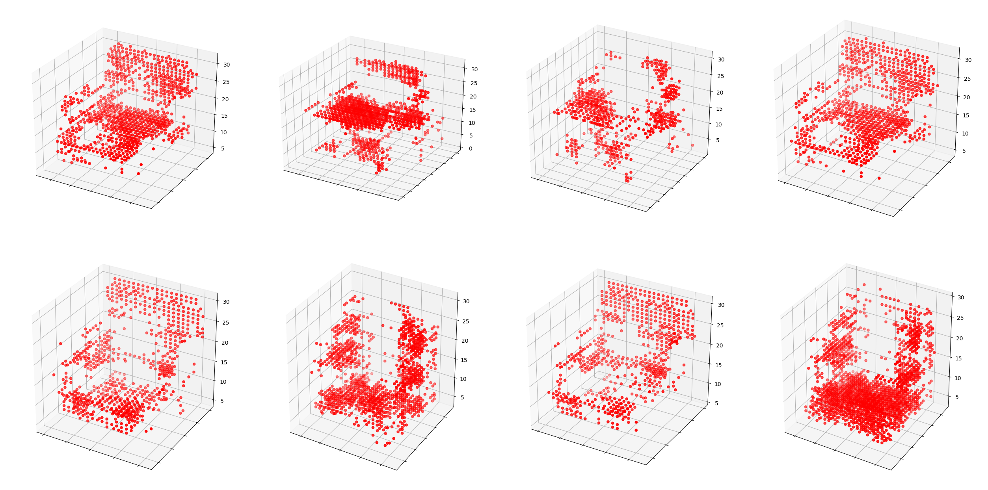
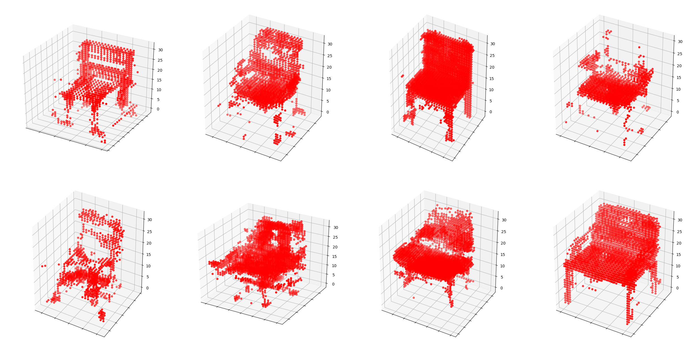
Initial Results
1000 Training Iterations
3DGAN
3DVAEGAN

Slide 7
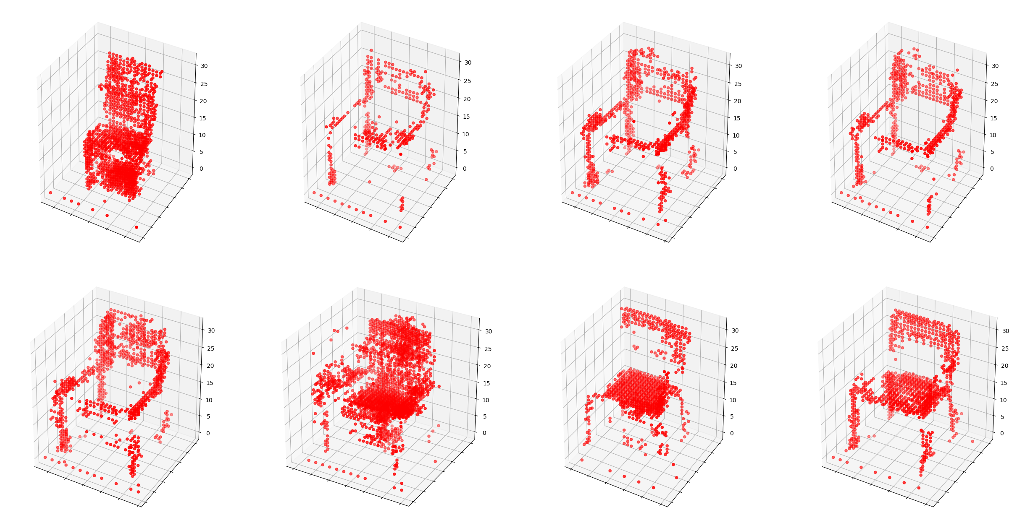
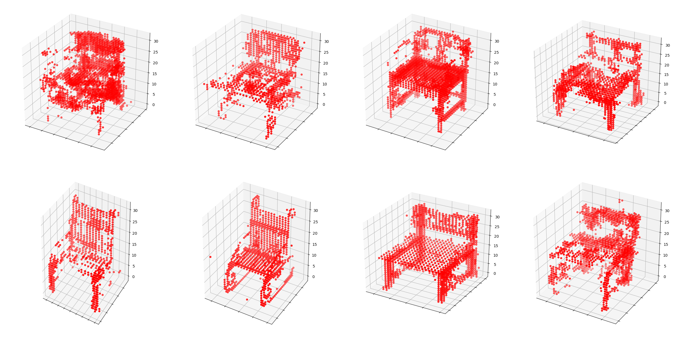
Initial Results
2000 Training Iterations
3DGAN
3DVAEGAN

Slide 8
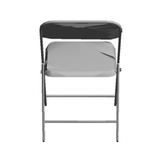
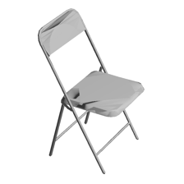
Multi View 3D VAE GAN
Real 3D Model (Training Set)
Z
Mean
Std
Discriminator
Real
Z
Generator
Mean
?
Fake 3D Model
Fake
Std
Z
Mean
Std

Slide 9
Thank you!

Slide 10
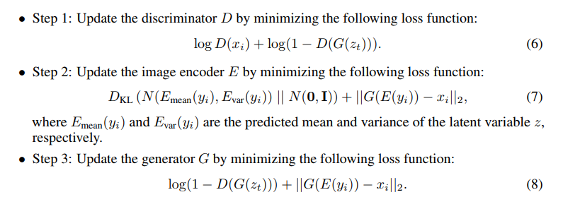
3D VAE GAN Loss Equations

Slide 11
References
[1] J. Wu, C. Zhang, T. Xue, B. Freeman, and J. Tenenbaum. Learning a probabilistic latent space of object shapes via 3d generative-adversarial modeling. In NIPS, pages 82–90, 2016.
[2] Ian Goodfellow, Jean Pouget-Abadie, Mehdi Mirza, Bing Xu, David Warde-Farley, Sherjil Ozair, Aaron Courville, and Yoshua Bengio. Generative adversarial nets. In NIPS, 2014.
[3] Zhirong Wu, Shuran Song, Aditya Khosla, Fisher Yu, Linguang Zhang, Xiaoou Tang, and Jianxiong Xiao. 3d shapenets: A deep representation for volumetric shapes. In CVPR, 2015.
[4] https://github.com/rimchang/3DGAN-Pytorch

